Slide 1
Decision Tree Classifier Project-8

Slide 2
Objectives
Using Decision Tree Model:
Prediction of the Iphones purchased on the basis of genders, age and salary.
To draw insights by performing EDA on the data
Model building and prediction
Business Impact

Slide 3
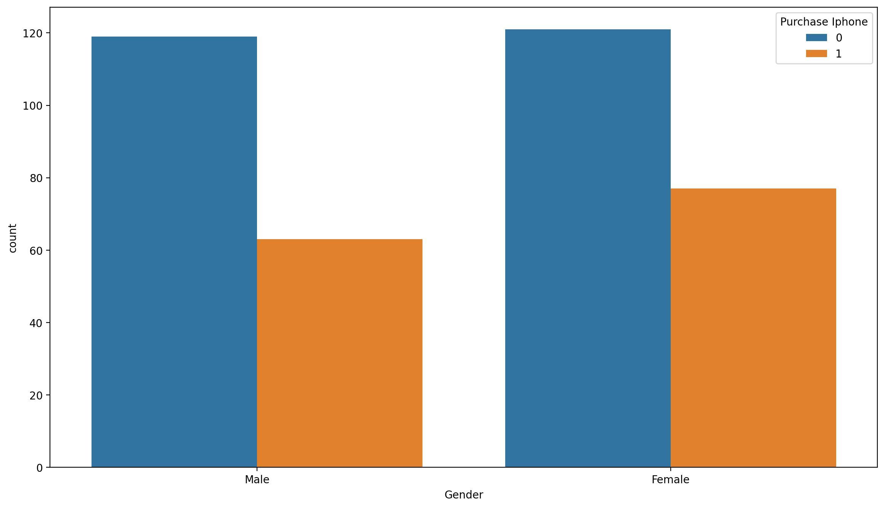
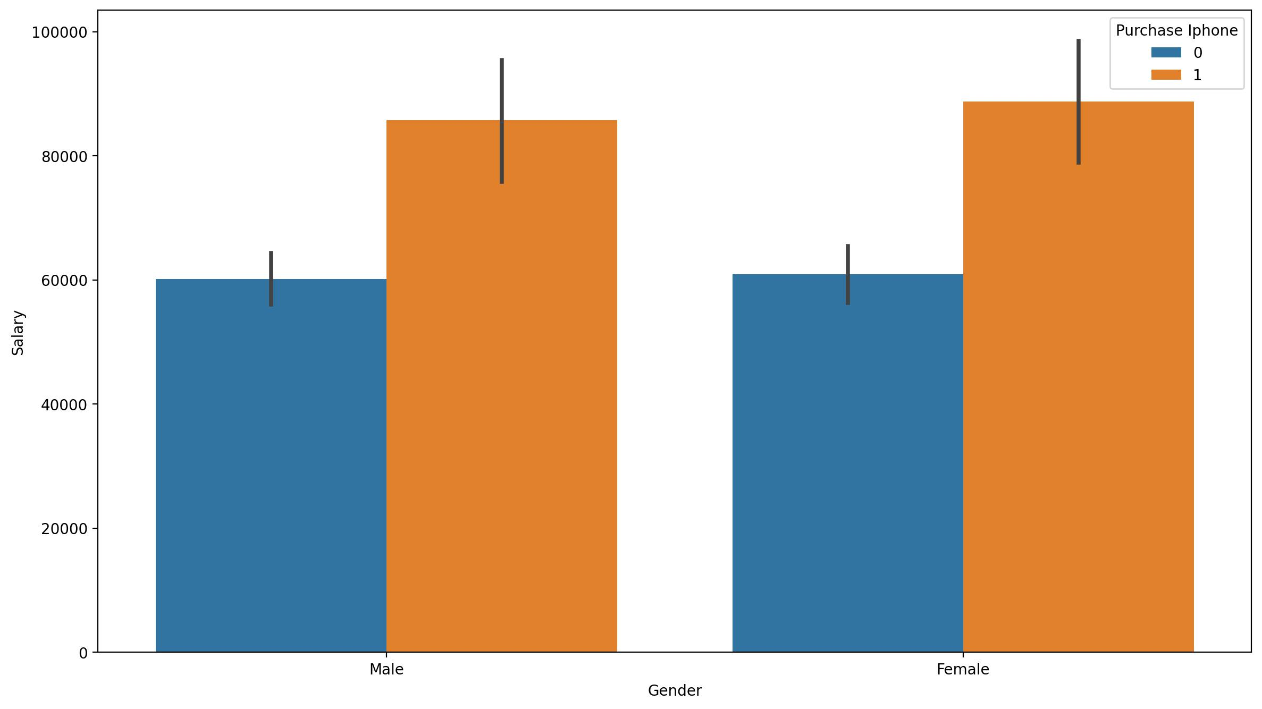
Exploratory Data Analysis on the data
Gender and Salary wise variation in purchase of Iphones
(1)
(2)
Figure 1 depicts that females purchased more Iphones compared to males.
Out of 198 females, 77 has purchased Iphones while out of 182 males, 63 has purchased Iphones.
Figure 2 depicts that genders with high salaries are likely to purchase Iphones.

Slide 4
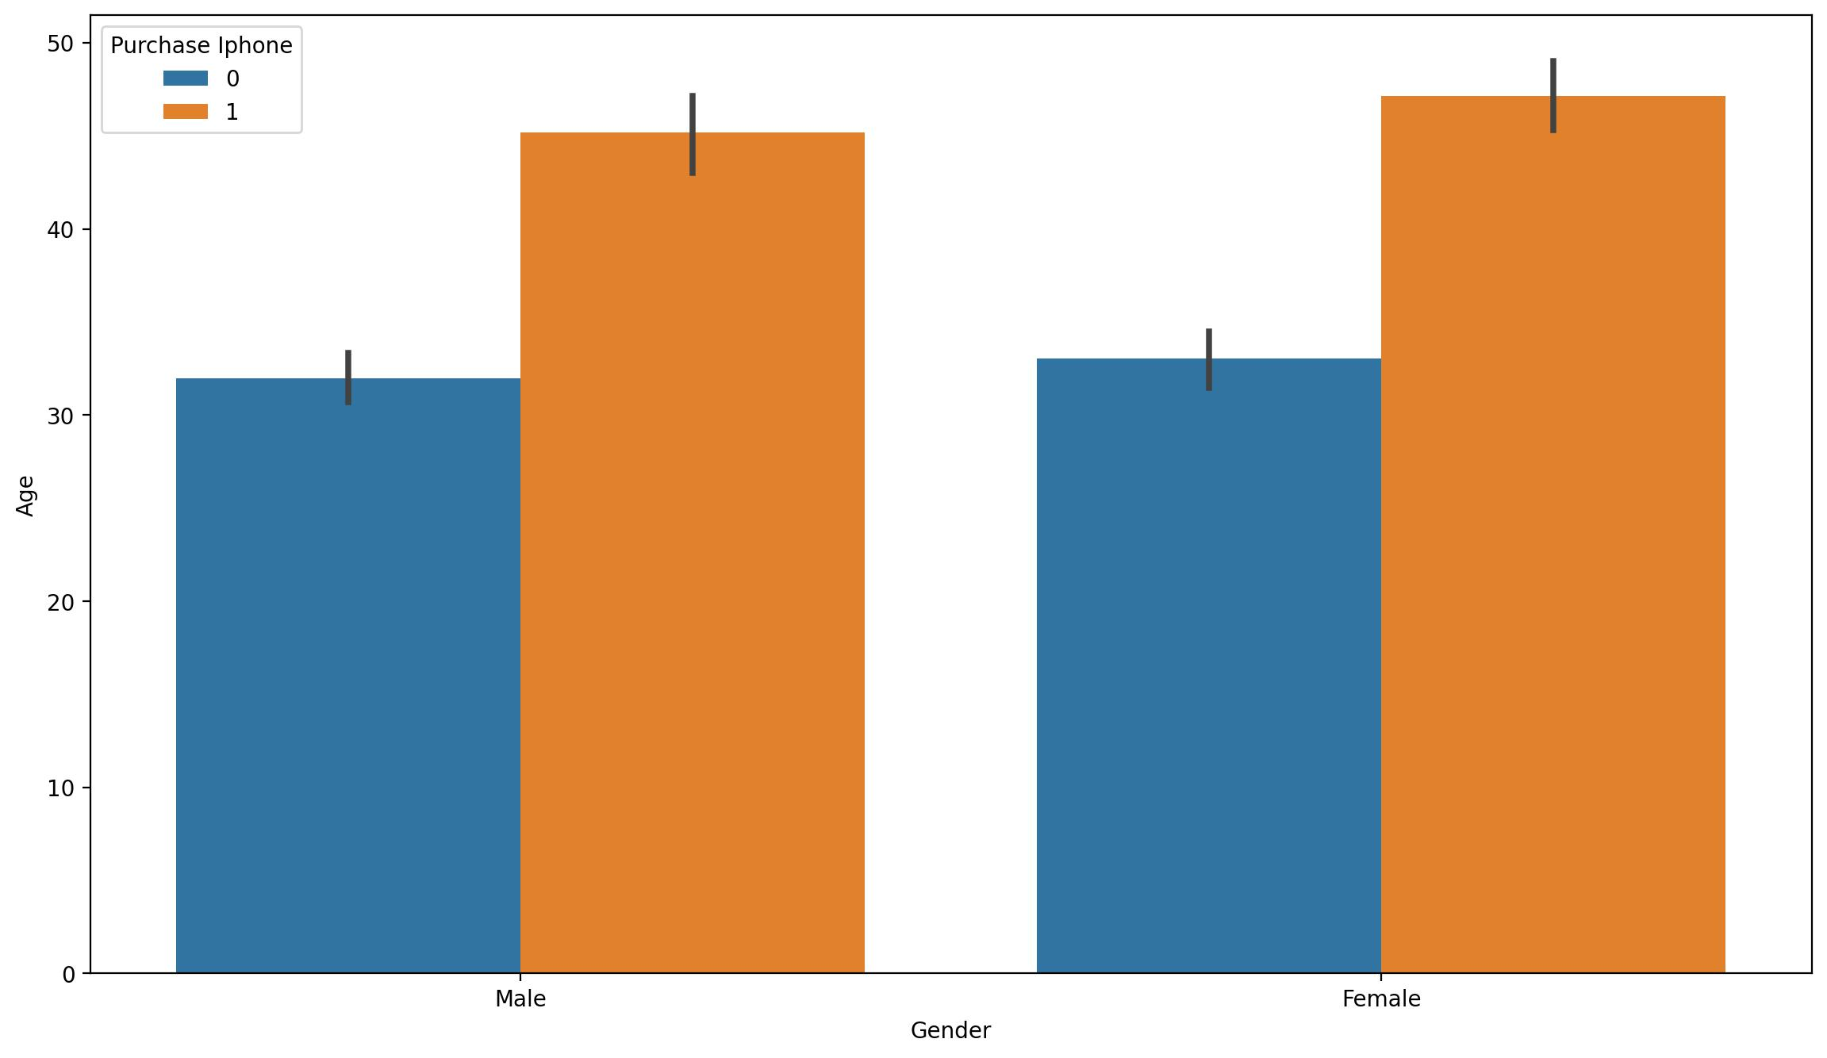
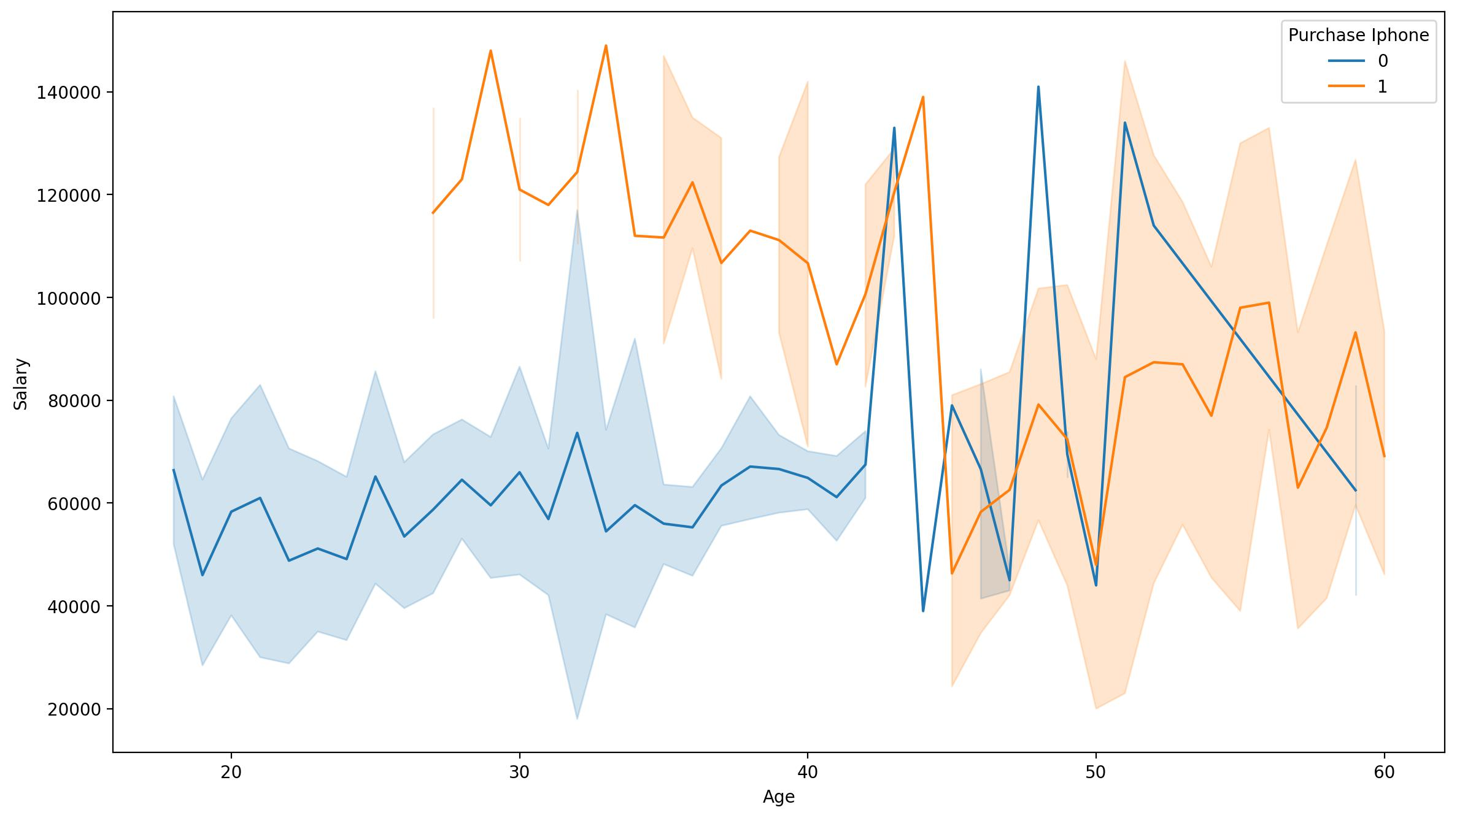
Exploratory Data Analysis on the data
Gender and Age wise variation in purchase of Iphones
(3)
(4)
(3)
Figure 3 and 4 depicts that genders with high salaries in 27-45 years of age have purchased Iphones.
Genders having age group above 45 years purchased Iphones irrespective of their salaries.

Slide 5
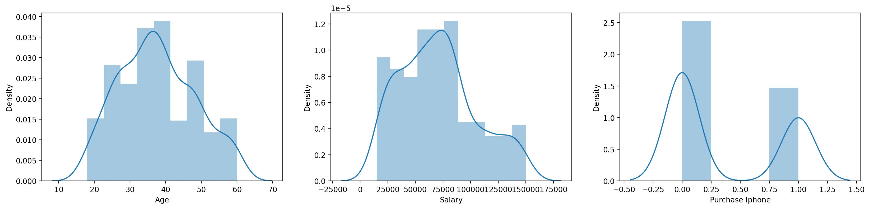
Exploratory Data Analysis on the data
Distribution of data features
The data is normally distributed in all the cases.
The skewness is calculated to be 0.23, 0.46 and 0.54 for age, salary and purchase Iphones, respectively.

Slide 6
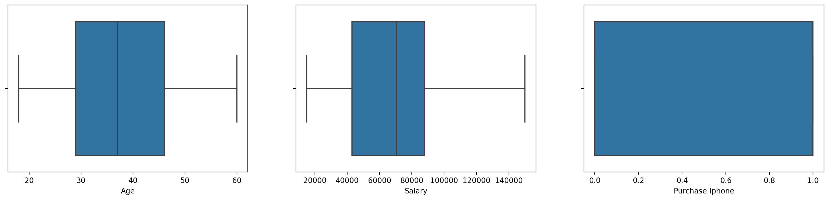
Exploratory Data Analysis on the data
Outliers detection using box plot
There are no Outliers in the data.

Slide 7
The dataset is solved by Decision Tree.
Accuracy score: 0.92
Precision score: 0.92
The models has shown very strong accuracy.
The model is strongest when approaches 1 and weakest when approaches 0.

Slide 8
Business Impact
Targeted Marketing Campaigns:
Tailor marketing campaigns based on predicted iPhone purchase behavior linked to gender, age, and salary ranges.
Maximize advertising efficiency by directing efforts toward demographics more likely to make a purchase.
Inventory Management:
Optimize iPhone inventory levels by aligning stock with predicted demand from specific gender and age groups.
Minimize excess stock or shortages, ensuring efficient use of resources and capital.
Market Positioning:
Leverage insights to strategically position iPhones in the market based on demographic preferences.
Adjust product features, marketing messages, and distribution channels to align with identified consumer segments.
Budget Allocation:
Allocate marketing budgets more effectively by focusing spending on demographics with higher predicted purchase rates.
Maximize the return on investment in marketing initiatives.
Customer Retention Strategies:
Develop targeted retention strategies for specific demographics to nurture long-term customer relationships.
Identify loyalty programs or incentives that resonate with different gender and age groups.

Slide 9
Business Impact
Competitive Edge:
Gain a competitive advantage by leveraging predictive insights to stay ahead of market trends.
Continuously refine strategies based on real-time data, positioning the brand as innovative and customer-centric.
Financial Forecasting:
Improve financial forecasting by integrating predicted iPhone purchase patterns into budgetary planning.
Enhance accuracy in revenue projections and resource allocation.
Brand Perception Enhancement:
Shape brand perception by aligning marketing efforts with values and preferences of different demographic segments.
Foster a positive and inclusive brand image.

